Slide 1
Augmented Chatbots :
Personalizing Text With Natural Language Generation
By Aashish Nair

Slide 2

Introduction
Chatbots have emerged as a highly demanded tool in many businesses and organizations.
Saves time, money, and manpower
40% of internet users prefer it to virtual agents
Utilized in various industries
Inflexibility in bot performance limit application
Trained with pre-written responses (no creativity)
Devoid of actual “personality”

Slide 3

Problem Statement
Explore the prospect “personalized” responses with natural language generation
Incorporate creativity and flexibility into bots
Return responses that are customized for the individual
Portray a “tone” or “emotion” that aligns with the service provided
A personalized question-and-answer system can:
Increase the number of uses and applications of such technology
Improve customer mood and loyalty

Slide 4

Data
Twitter
Text database of various personalities
A platform that where people write with emotion
Dataset
Tweets retrieved through Kaggle.com and data scraping software
50,000+ tweets of 30 celebrities

Slide 5
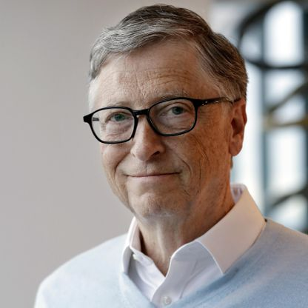
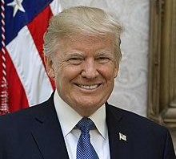
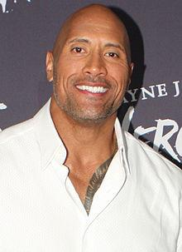
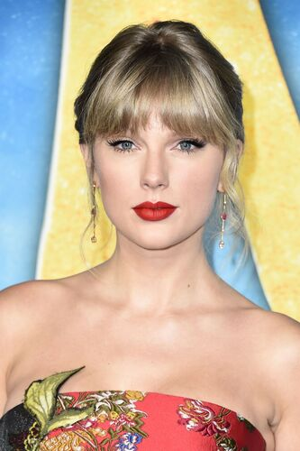
Data
Dataset
50,000+ tweets of 30 celebrities

Slide 6

Data Preprocessing
Data processing entailed:
Omission of retweets and null data
Filtering out characters that are not alphabet, number, or punctuation
Removal of links and emojis
Removal of tweets with less than 3 words of text
36,343 Tweets remaining after preprocessing

Slide 7
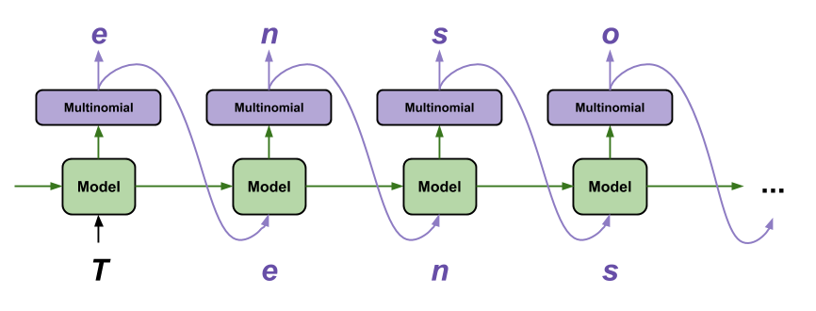
Data Modeling For Text Generation
Text Generation can be achieved with:
Recurrent Neural Network (RNN)
The GPT-2 model

Slide 8
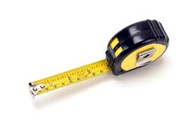
Evaluation Metrics
How do you evaluate text generation?
How do you quantify personality?

Slide 9
Evaluation Metrics
Quantifiable Metrics (Disparity between real and generated text)
Average Sentence Length (99% Confidence Interval)
Sentiment Score (ranging from -1 to 1)
Scores must differ by less than 0.1
Subjectivity Score (ranging from 0 to 1)
Scores must differ by less than 0.1
Human-centric judgement (qualitative)
Is the text clear and coherent?
Does the text resemble the original text?
Does the generated text utilize the same language? (Word Cloud)

Slide 10
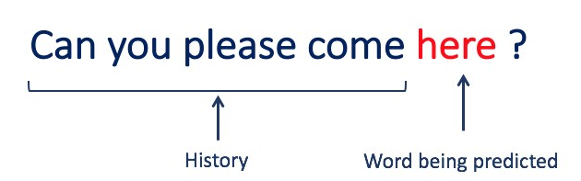
Recurrent Neural Network Models
Train a model to predict the following character of a given sequence
Tweets turned into sequences with 50 characters with 1 character output
Two models:
1 baseline (No complexities)
1 modified
Tweaked parameters:
Number of layers and neurons
Activation function
Learning rate
Temperature

Slide 11
LSTM results summary
LSTM models performance is underwhelming
Multiple typos in each sentence
Grammatical errors
Unqualified for evaluation with performance metrics
Sample text:
“we must courag our wa oved on the fice”
“wish make in feal this millions an e why with full at of fight parts”
“i will have a their bring life sponer fight.”

Slide 12

GPT-2 Model
OpenAI’s pretrained language model
Trained on 8 million web pages
Has 124 million parameters
Main parameters: top_k and temperature
Top_k: Number of tokens considered for each step
Temperature: refers to randomness in text selection

Slide 13
GPT-2 Results Analysis
GPT-2 model trained with temperature = 0.7, top_k = 0
GPT-2 model delivers mixed results
Resembles original text at eye level
Meets sentence length conditions for 16/30 personalities
Meets sentiment score conditions for 15/30 personalities
Meets subjectivity score conditions for 10/30 personalities
No correlation between the performance of the text generating model and celebrity’s occupation

Slide 14
Results
Results are illustrated with Tableau

Slide 15
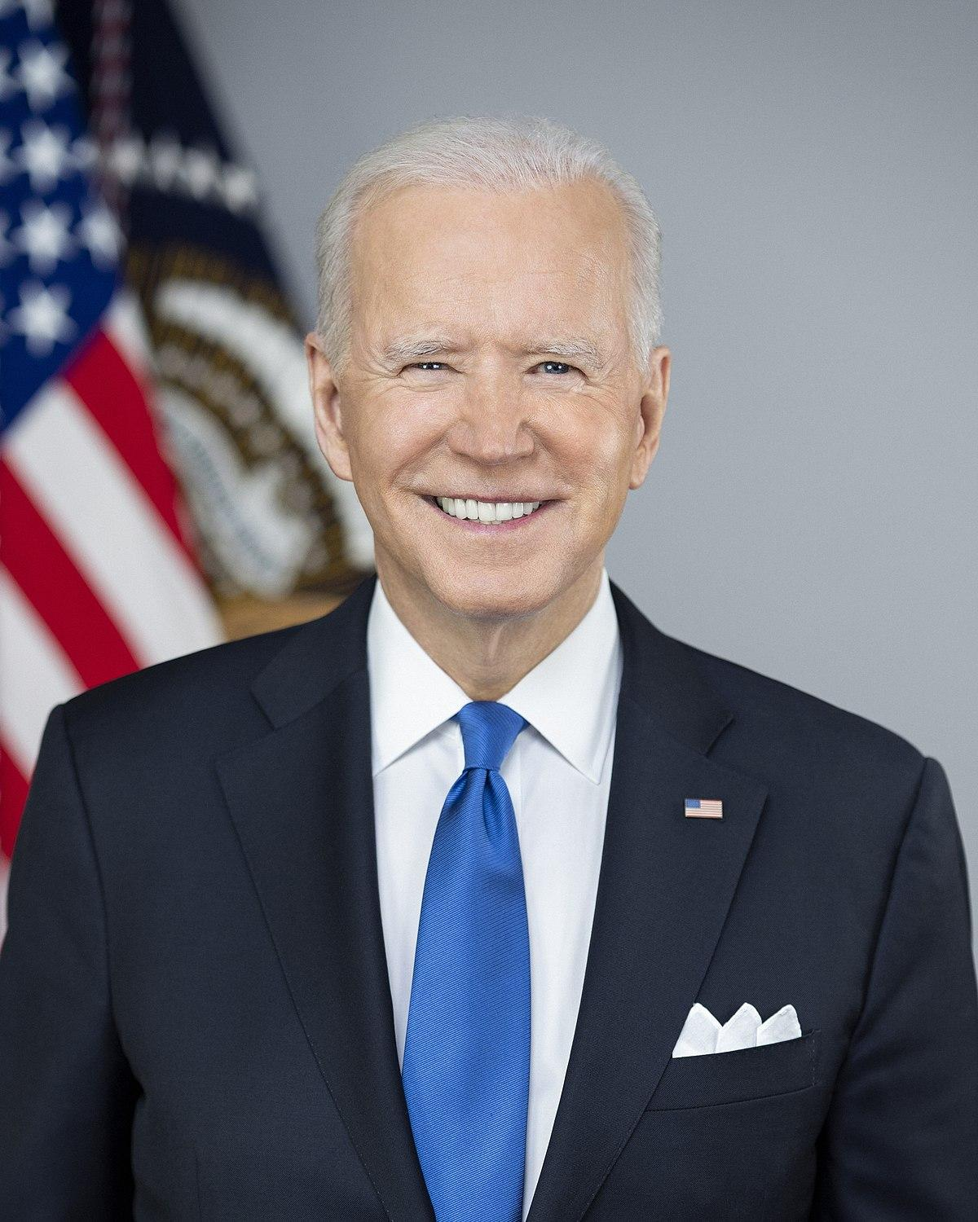
Example: Joe Biden
Name: Joe Biden
Occupation: US President
Data Size: 5,904 Tweets

Slide 16
Sample Generated Text (LSTM Model)
“we can get a more my can beba ays community the rights of his organors and the brave. join us.”
“we need is work to of suppers dowers who the spow”
“they need and the with leest, the campaign to do ago it will.”

Slide 17
Sample Generated Text (GPT-2 Model)
“as i take the stage, i'm going to tell folks that there is no place for racism in america”.”
“every american deserves to have the opportunity to vote”
“we need a president who will unite us and lead us through this moment”

Slide 18
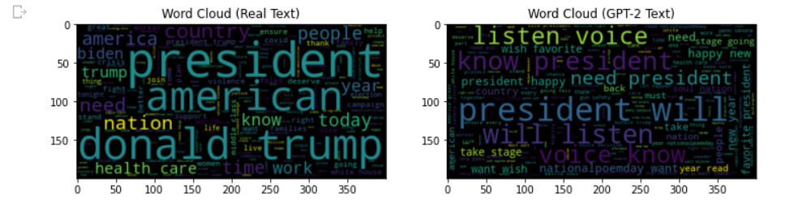
Evaluation Metric: Word Choice

Slide 19
Evaluation metric: Average Sentence Length
H0: The difference between the average sentence length of the real and generated text is 0.
H1: The difference between the average sentence length of the real and generated text is not 0.
99% CI of Average Sentence Length of Real text: (16.48, 17.01)
99% CI of Average Sentence Length of Generated Text: (14.78, 17.95)
Verdict: Do not reject the null hypothesis

Slide 20
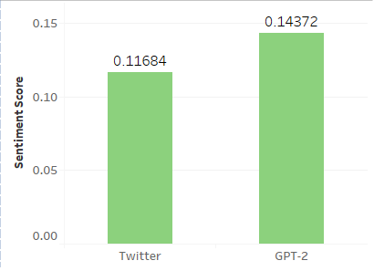
Evaluation Metric: Sentiment Score
Benchmark: Sentiment Score of generated text can only deviate from score of real text by 0.1

Slide 21
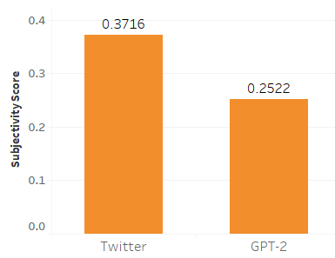
Evaluation Metric: Subjectivity Score
Benchmark: Subjectivity score of generated text can only deviate from score of real text by 0.1

Slide 22
Results Summary
The generated text from the GPT-2 model of each celebrity bare similarities:
Resemblance to original text on eye level
Similar average sentence length values
Drastically different sentiment and subjectivity scores compared to original text
Somewhat similar word clouds

Slide 23
Conclusion
The GPT-2 model with a higher temperature is optimal
LSTM models lacked needed complexity
GPT-2’s generated text passed human-centric evaluation
Generated text only met quantifiable requirements for ½ of the celebrities

Slide 24
Recommendations
Collect larger datasets
Explore other architectures
Conduct a more thorough hyperparameter tuning
Improve evaluation metrics
How to measure “personality”
How to gauge it qualitatively

Slide 25
THANK YOU!

